Slide 1

Food Ordering Web Application
Presented By :
Vineet Rathor
Saurabh Singh
Rajeev Ranjan Chaturvedi

Slide 2
Outline
Abstract
Introduction
Objective
Project

Slide 3
Abstract:
ONLINE FOOD DELIVERY SYSTEM is a website designed primarily for use in the food delivery industry. This system will allow hotels and restaurants to increase scope of business by reducing the labor cost involved. The system also allows to quickly and easily manage an online menu which customers can browse and use to place orders with just few clicks. Thus it is a simple, fast and convenient food ordering system giving an edge over the competition at an affordable price.

Slide 4
Introduction:
Online ordering system that I am proposing here, greatly simplifies the ordering process for both the customer and the restaurant. System presents an interactive and up-to-date menu with all available options in an easy to use manner. Customer can choose one or more items to place an order which will land in the Cart. Customer can view all the order details in the cart before checking out. Customer can give their valuable feedback about the food and website also.

Slide 5
Objective:
Develop a system that will allow customers to place their food order online and provide them with feedback, a generic image of the meal with the price of the meal as well as restaurant from where it will be delivered, a list of side dishes and main course ingredients.

Slide 6
A Project Work On
Food Ordering Web Application
Project Mentor : Mr. Pankaj Kapoor

Slide 7
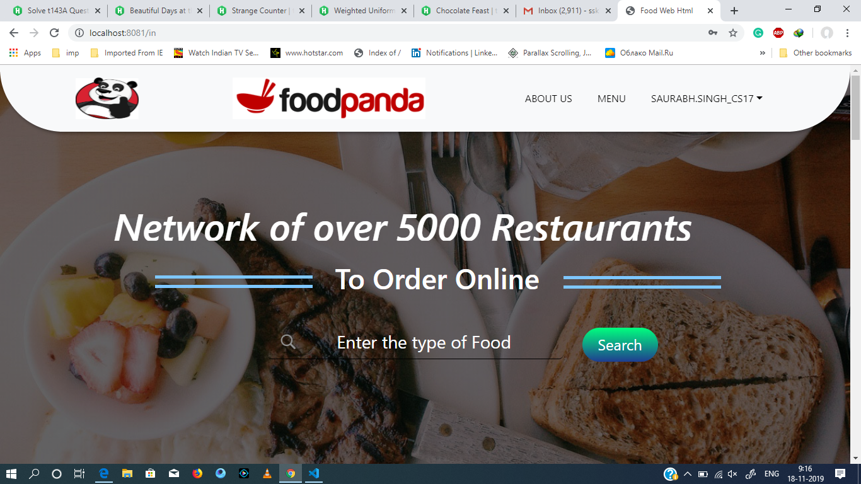
Main Page

Slide 8
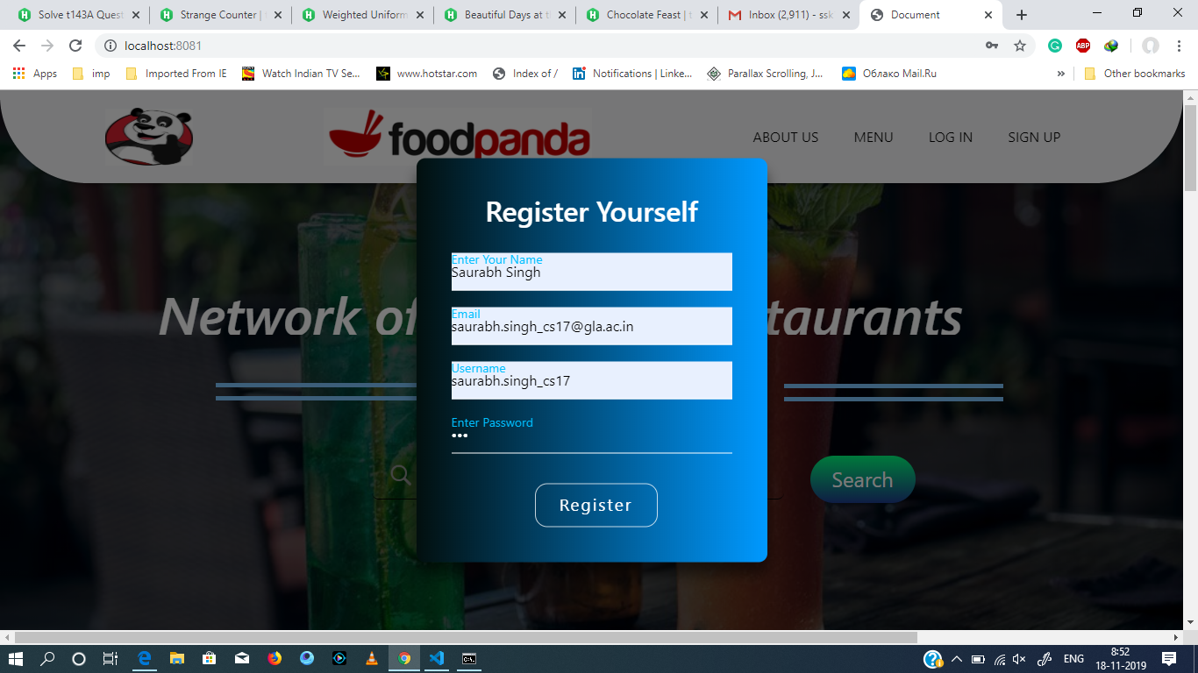
Sign up Page

Slide 9
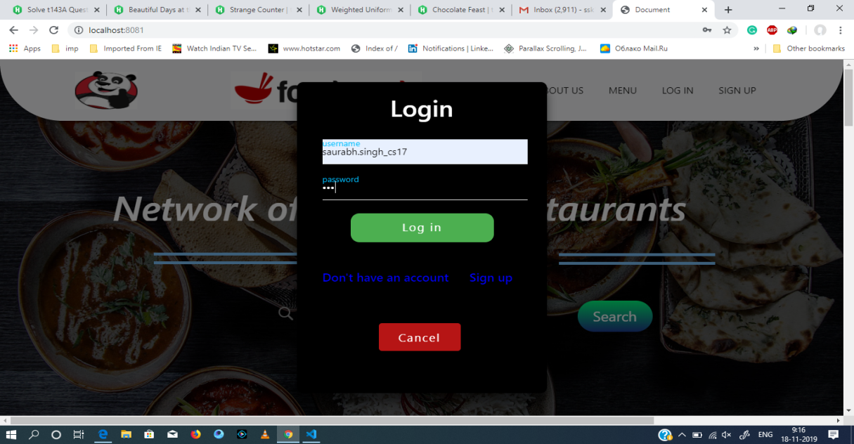
Login Up Page

Slide 10
Login Page (2)
Username at the top right corner after Login

Slide 11
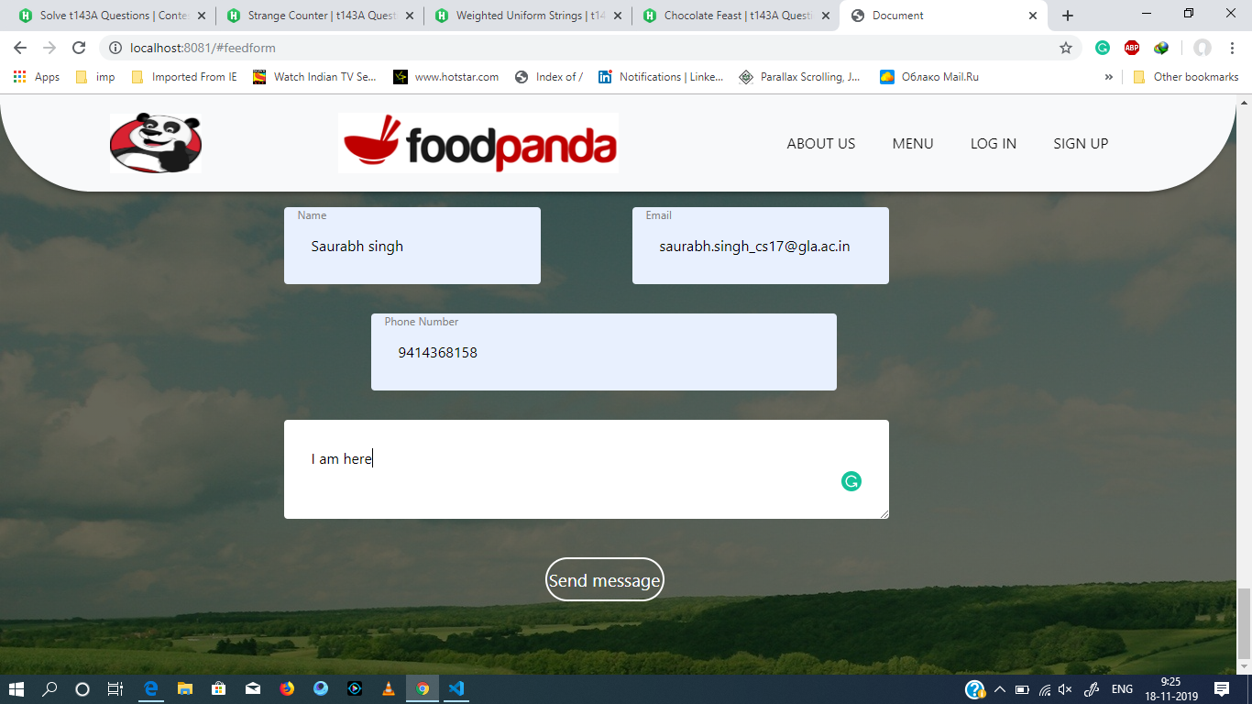
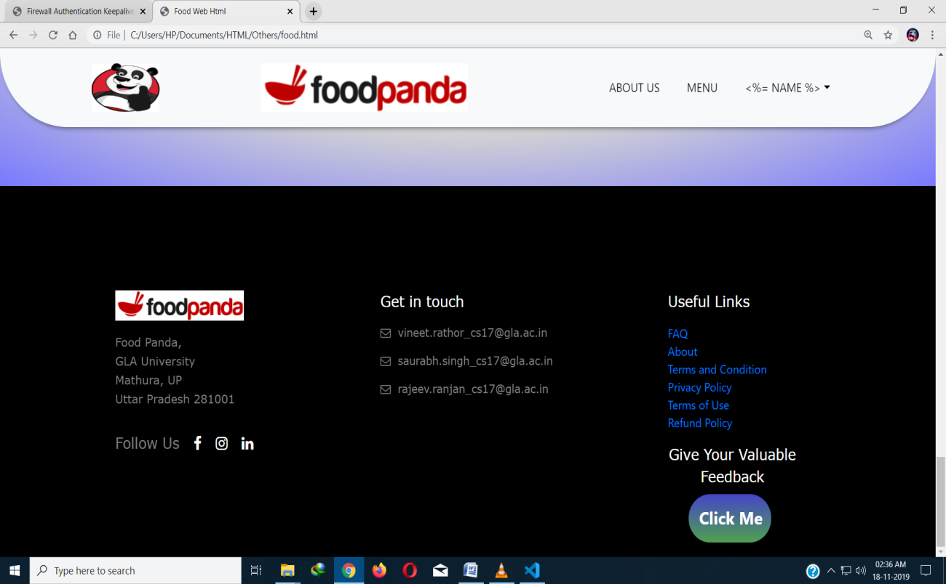
Feedback Page
User has to click on this button to open feedback form

Slide 12
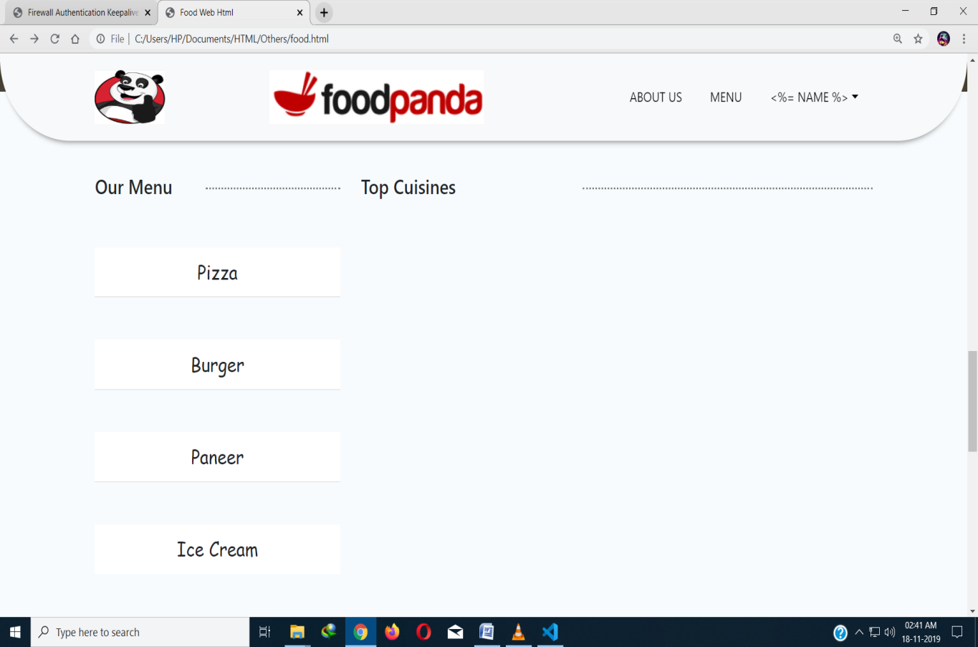
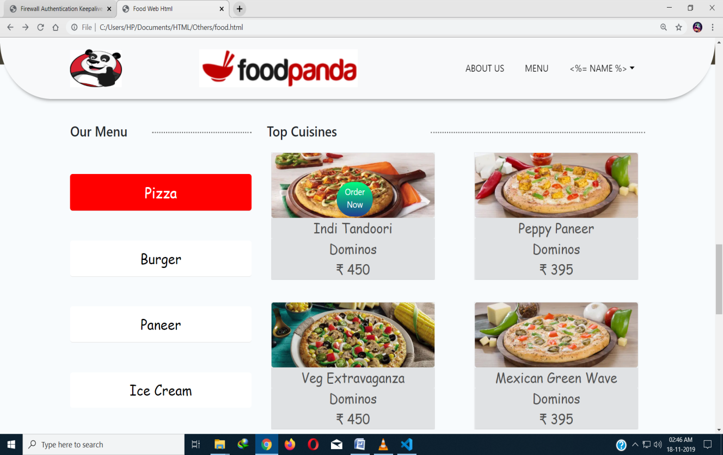
Menu Section
This is Menu section , to view the food items , user needs to click on any above given type of food.
Pizza food items will display on clicking on pizza option

Slide 13
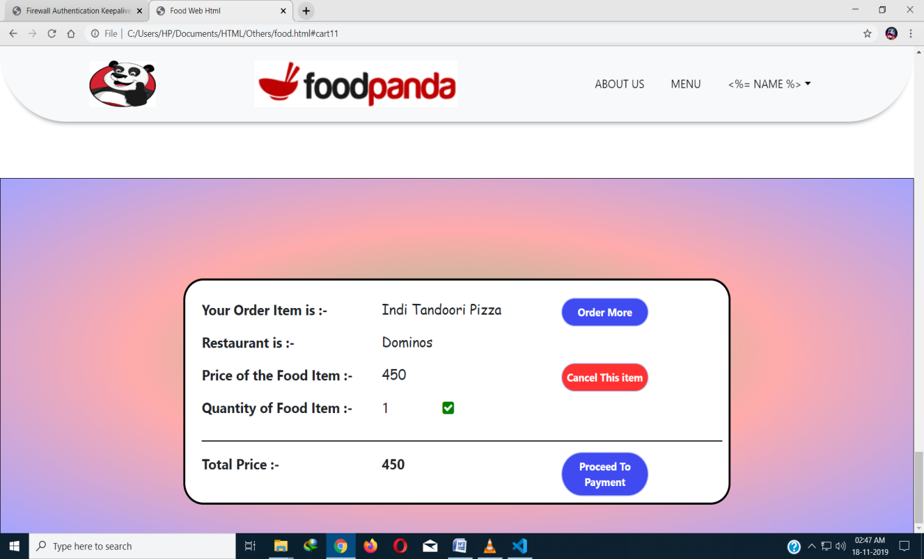
Ordering Cart section
Faculty can view the timetable of any course
On clicking the option of order now on when user hovers over any food item will display this form if user is logged in otherwise alert message will be displayed and log form will display as popup.
Faculty can upload documents in pdf format only

Slide 14
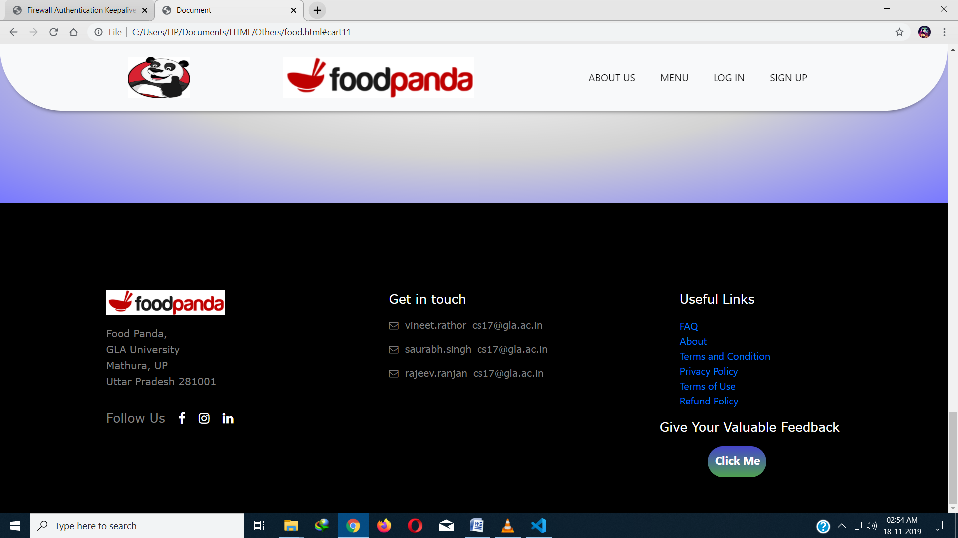
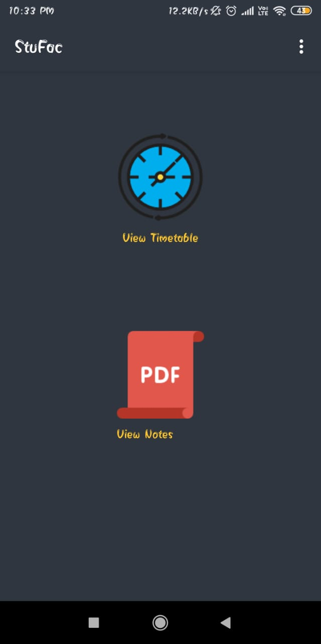
About Us section
Student can view the Timetable here of any course
Student can view/download pdf here that the faculty has shared

Slide 15
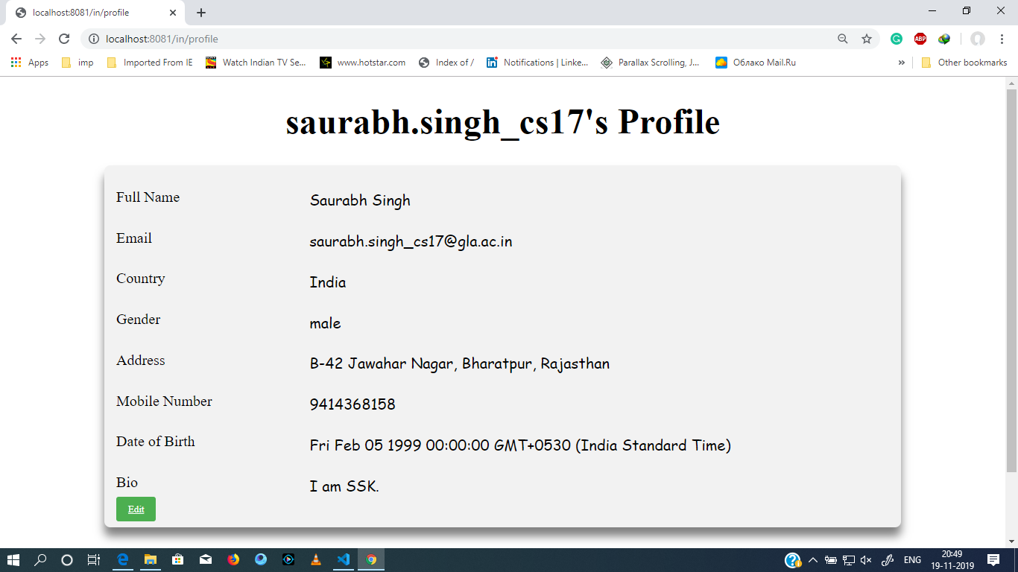
Profile Page
User can edit the values given in the profile page and these values will be saved in specific user’s database
Here’s the download option

Slide 16
References
https://nodejs.org/en/
https://www.npmjs.com/
https://expressjs.com/
https://socket.io/
https://getbootstrap.com/
https://www.w3schools.com/html/
https://www.w3schools.com/css/
https://www.w3schools.com/js/lt.asp
https://www.mongodb.com/

Slide 17
Thank You All !!

